Slide 1
CAR Review – December 2014 Dale – Chris – Jenni
143913608, 143913105, 143913946, 143913176

Slide 2
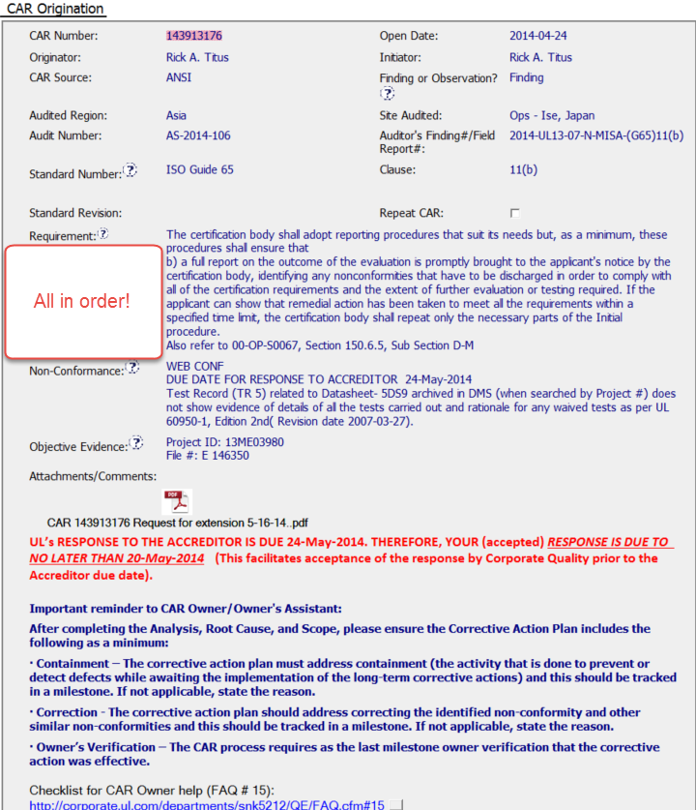
ECAR 143913176 – CAR Origination Section, Part 1 & 2

Slide 3
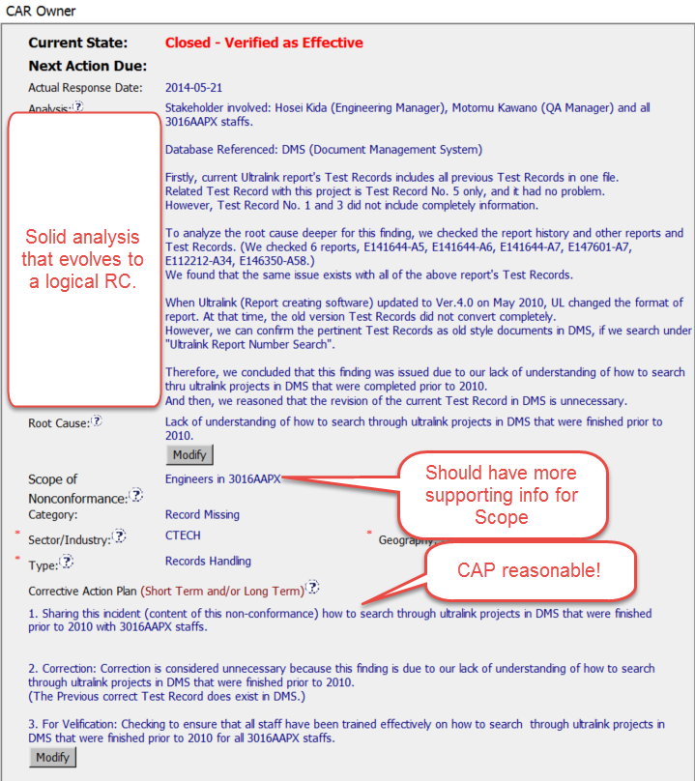
ECAR 143913176 – CAR Owner Section

Slide 4
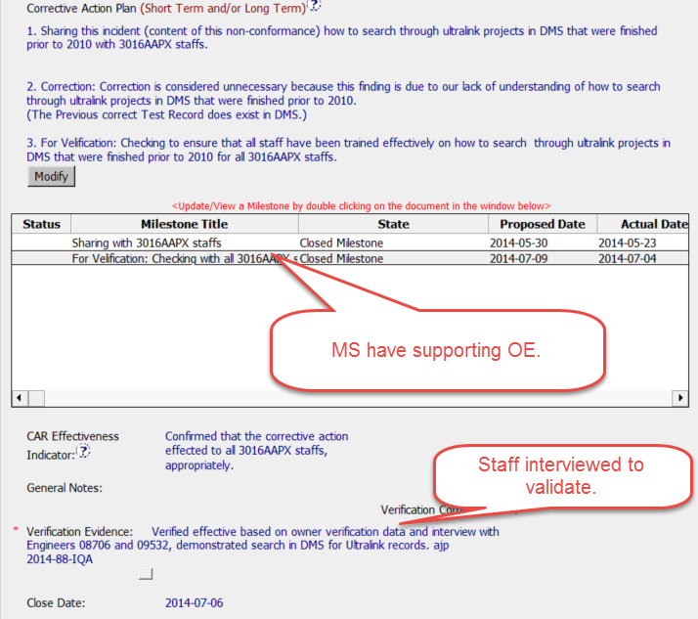
ECAR 143913176 - CAP

Slide 5
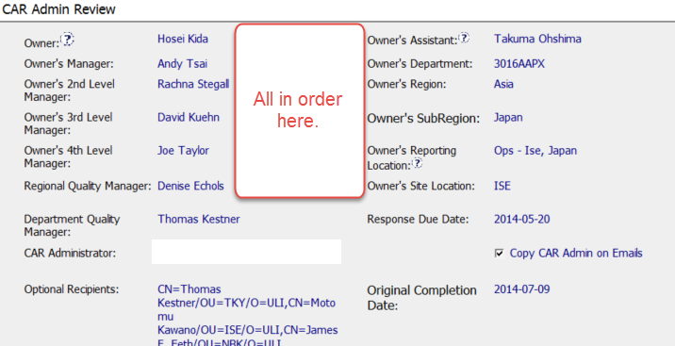
ECAR143913176 – CAR Admin Review Section

Slide 6
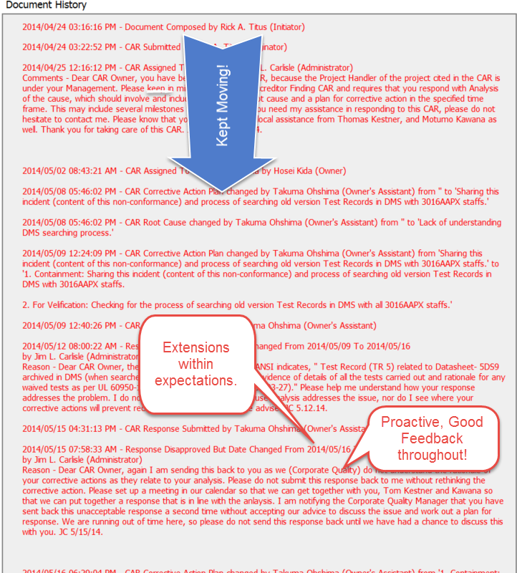
ECAR 143913176 – Doc History

Slide 7
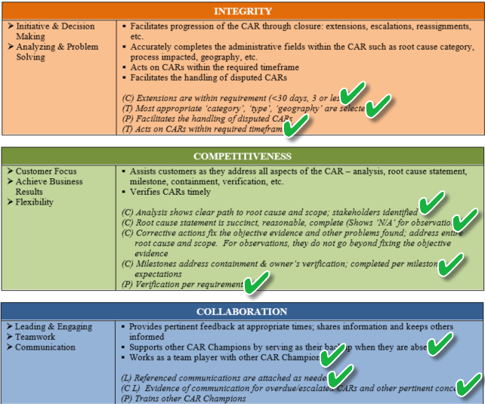
ECAR Admin CBS’s

